Slide 1
Azure Storage Redundancy Option Selection Study
Comparative Analysis of LRS, ZRS, GRS and RA-GRS.
TEAM MEMBERS:
D.SURYA-2400030289
SK.SHAHEEN-2400030304
G.DINESH-2400030443
M.KIRAN-240030365

Slide 2
PROBLEM STATEMENT
Cloud applications require reliable and highly available storage to protect data from hardware, zone, and regional failures. Azure provides multiple storage redundancy options such as LRS, ZRS, GRS, and RA-GRS, each offering different levels of data protection, availability, geographic replication, and cost.
This project aims to implement and compare these Azure Storage redundancy options using Blob Storage, test data accessibility and secondary-region access, and analyze their relative costs to understand the differences between the available redundancy configurations.

Slide 3
OBJECTIVES
Implement four Azure Storage redundancy options:
  LRS
  ZRS
  GRS
  RA-GRS
Create Blob Storage containers.
Upload and access a test .txt file.
Generate a secure SAS URL with read permission.
Test blob accessibility.
Test secondary-region access for RA-GRS.
Compare the redundancy options based on protection and cost.

Slide 4
AZURE STORAGE REDUNDANCY
Types of Redundancy
Type | Full Form | Main Feature
LRS | Locally Redundant Storage | Copies within the primary region
ZRS | Zone-Redundant Storage | Copies across availability zones
GRS | Geo-Redundant Storage | Replication to a secondary region
RA-GRS | Read-Access Geo-Redundant Storage | GRS + secondary read access

Slide 5
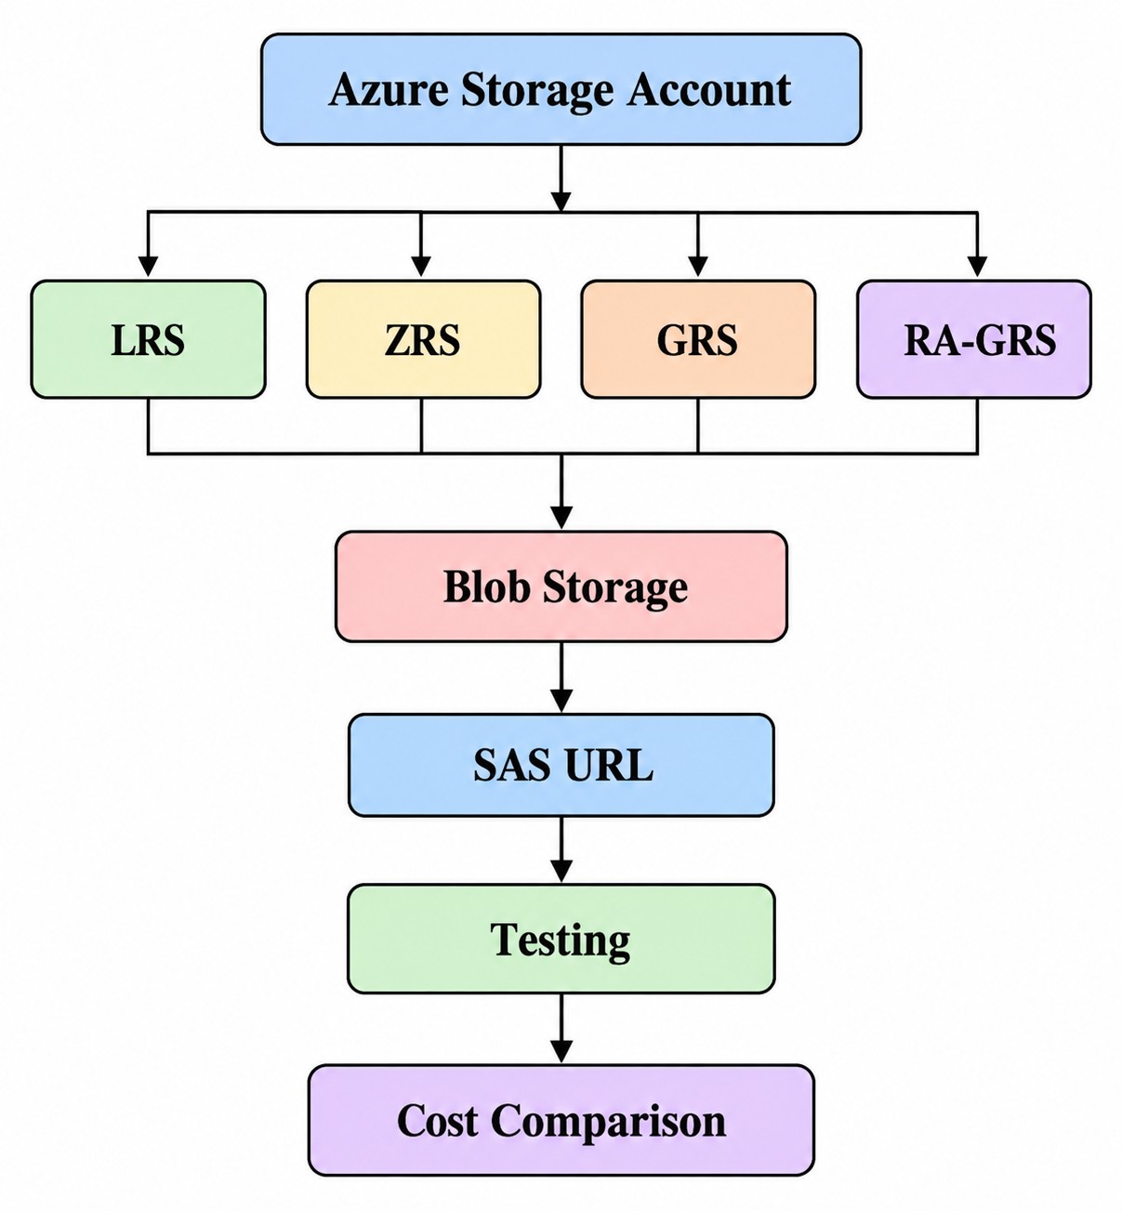
System Architecture

Slide 6
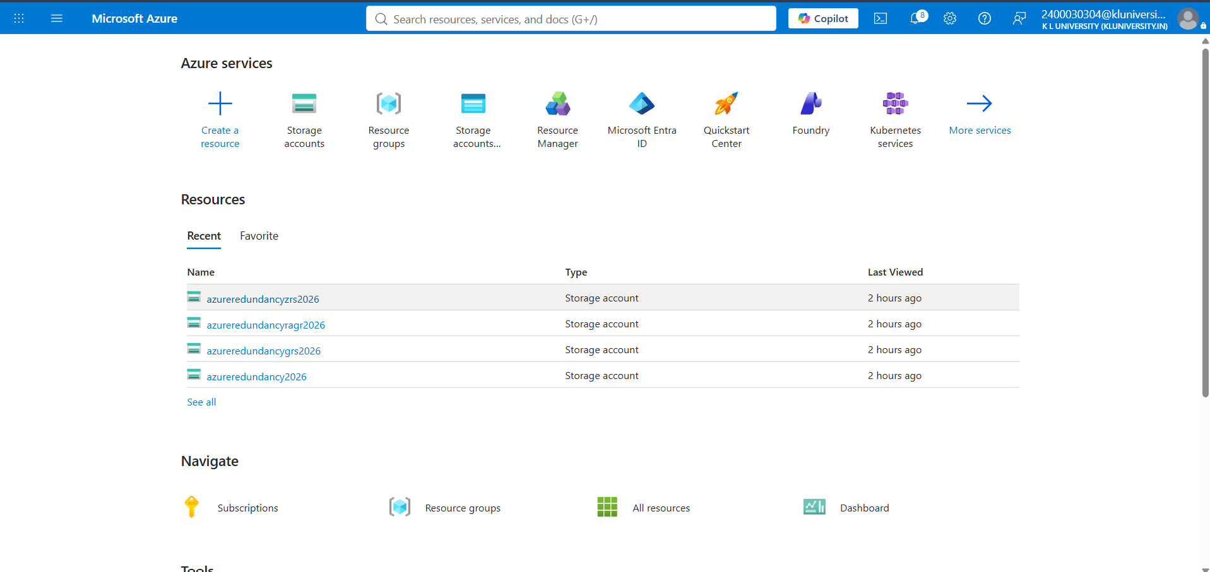
Implementation

Slide 7
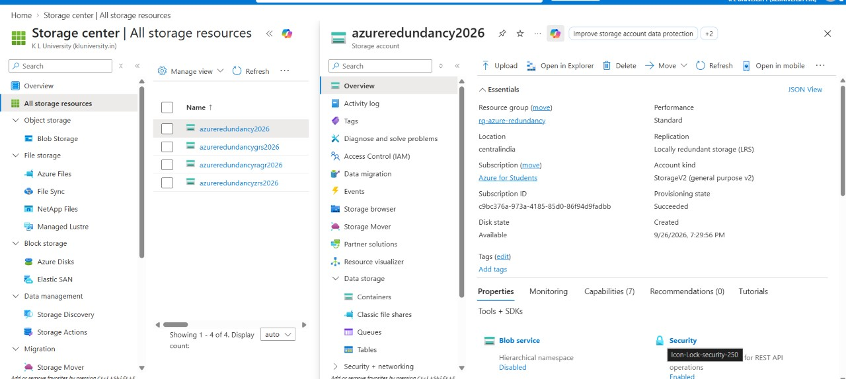
LRS-LOCALLY REDUNDANT STORAGE

Slide 8
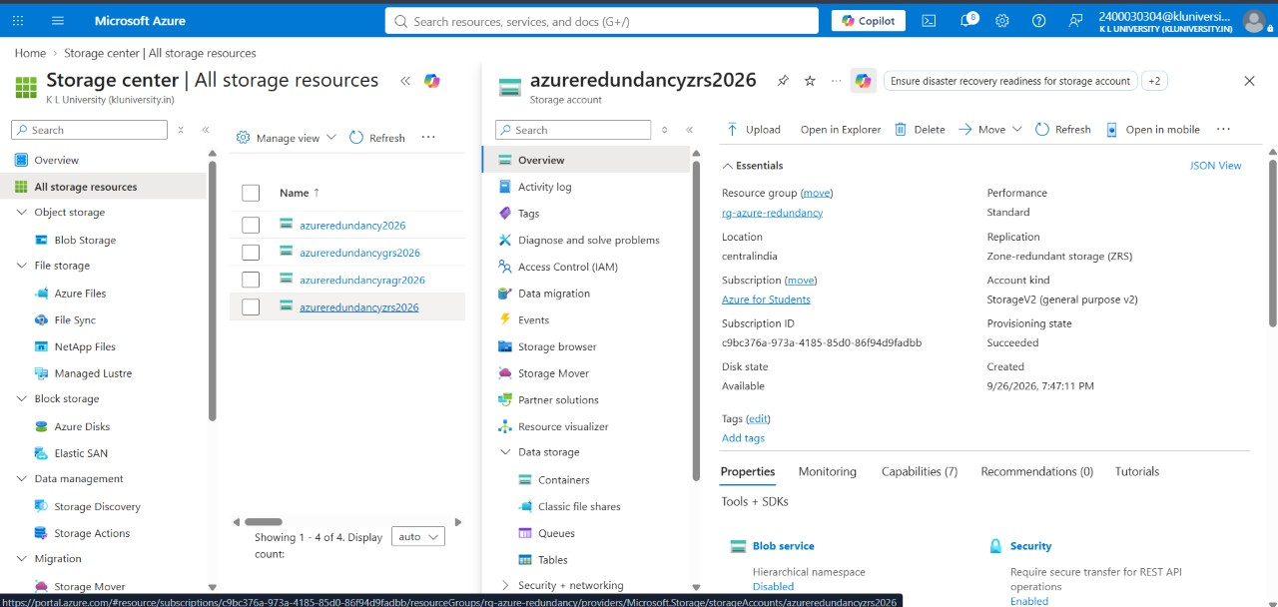
ZRS-ZONE REDUNDANT STORAGE

Slide 9
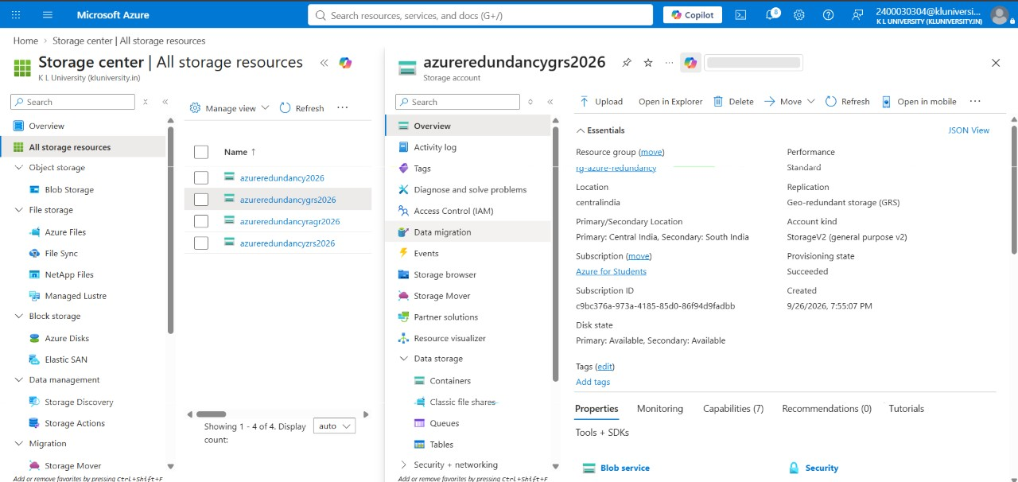
GRS-GEO REDUNDANT STORAGE

Slide 10
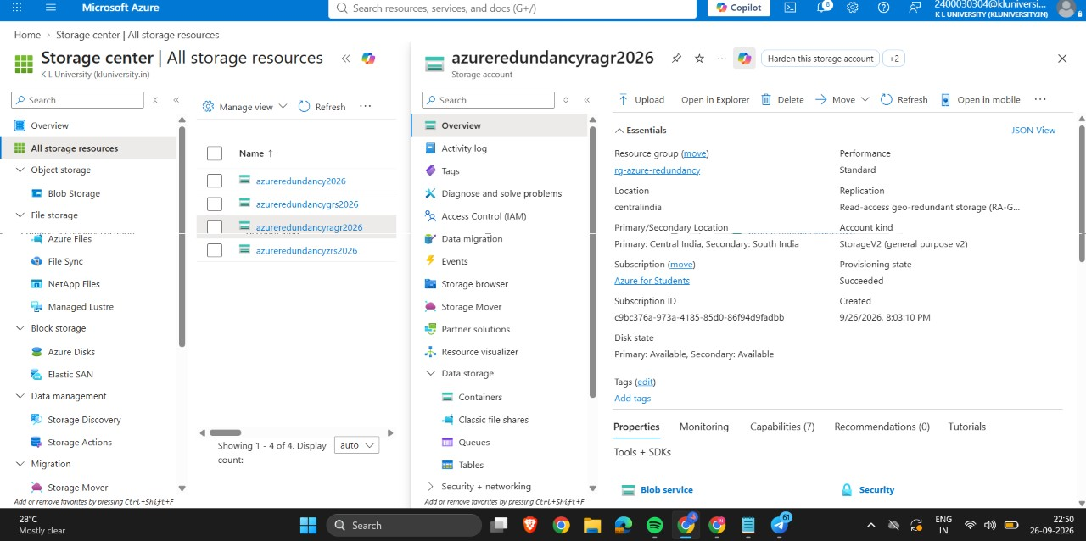
RA-GRS->READ ACCESS GEO REDUNDANT STORAGE

Slide 11
Results
Storage Type | Blob Access | Geo-Replication | Secondary Read
LRS | ✓ | No | No
ZRS | ✓ | No | No
GRS | ✓ | Yes | No
RA-GRS | ✓ | Yes | Yes

Slide 12
Cost Comparison
REDUNDANCY | RELATIVE COST | PROTECTION
LRS | Low | Local
ZRS | Higher than LRS | Availability-zone level
GRS | Higher | Geographic
RA-GRS | Higher | Geographic + secondary read

Slide 13
CONCLUSION
Azure provides multiple redundancy options for different availability and durability requirements.
LRS provides local redundancy.
ZRS provides protection across availability zones.
GRS provides replication to a secondary region.
RA-GRS adds read access to the secondary region.
SAS provides controlled, time-limited access to Blob Storage.
The project demonstrates how storage redundancy can be implemented and tested using Azure.

Slide 14
THANK YOU

